Slide 1
Analysis on global malnutrition
Based on data from 1983-2019 (kaggle.com)
Source : https://bit.ly/2ArgBZv

Slide 2

WHAT IS MALNUTRITION?
Malnutrition, as the name suggests, is the deficiency of essential nutrients in the regular diet, which results in serious health conditions. In developed and underdeveloped countries that are suffering from poverty, this is highly prevalent due to lack of food.

Slide 3
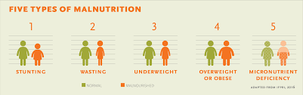
TYPES OF MALNUTRITION
Stunting - Low height for age
Wasting - Low weight for height
Underweight - Low weight for age
Overweight - High weight for height

Slide 4
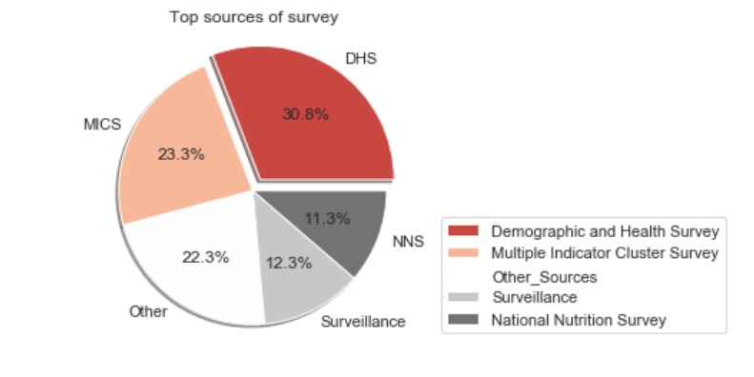
DATASET
A brief overview of data
Data is collected
from 1983-2019
across 152 countries.
for children < 5 years
by UNICEF/WHO/World Bank
Important parameters and indicators
Income Classification
Wasting
Underweight
Stunting
Overweight

Slide 5
QUESTIONS CONSIDERED FOR ANALYSIS
What is the average proportion of underweight by country's income group?
What are top-5 countries with highest proportion of the underweight in 2018?
What is the average proportion of all malnutrition types by country's income group?
What are top-5 countries with highest proportion of the overweight in 2018?
How has the country Tunisia developed over years in terms of the proportion of the overweight?
Is there a correlation between income group & under/overweight?
TOOLS & LANGUAGE USED TO ADDRESS THE QUESTIONS -
Jupyter Notebook, Python (pandas, numpy, matplotlib, seaborn)

Slide 6
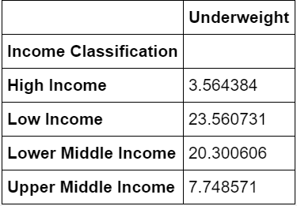
What is the average proportion of underweight by country's income group?

Slide 7
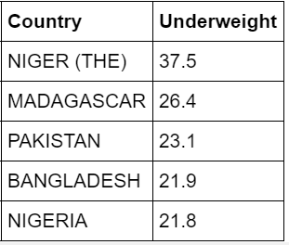
2. What are top-5 countries with highest proportion of the underweight in 2018?

Slide 8
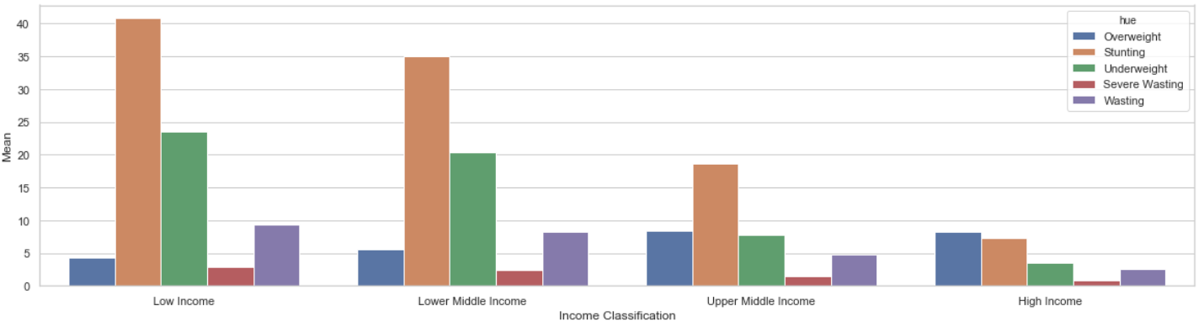
3. What is the average proportion of all malnutrition types by country's income group?
We can observe that low-income countries seem to suffer the most with high averages of all malnutrition types among its population, except Overweight.

Slide 9
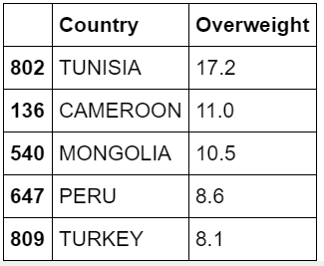
4. What are top-5 countries with highest proportion of the overweight in 2018?

Slide 10
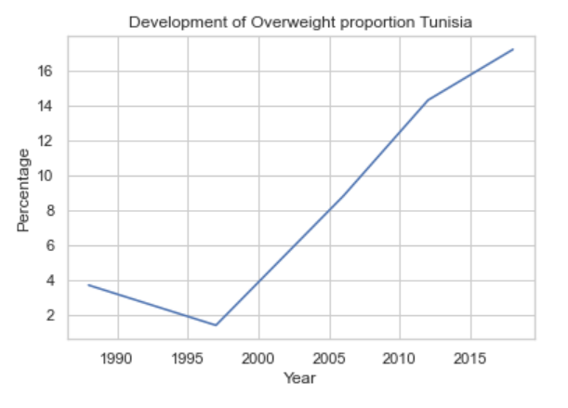
5. How has the country Tunisia developed over years in terms of the proportion of the overweight?

Slide 11
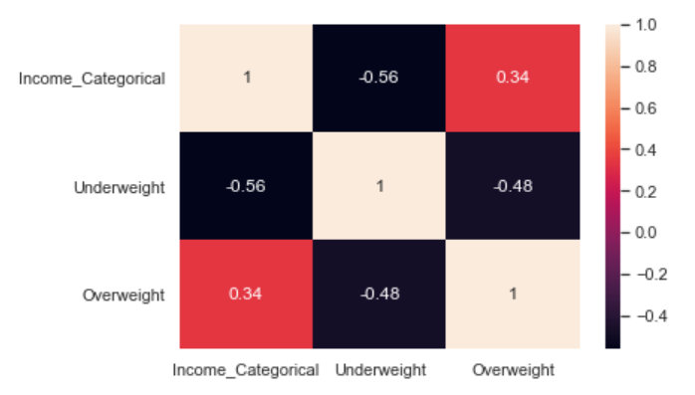
6. Is there a correlation between income group & under/overweight?
Observation :
There is a slightly positive correlation (r = 0.34) between Income-group and Overweight parameter.
A negative correlation (r = -0.56) exists between Income_group and Underweight parameter.
Correlation map

Slide 12

THANK YOU for the bootcamp and
giving us an amazing opportunity to present our Capstone assignment.
Olga Sholderer
Siham Agzennay
Lakshmi Soujanya
Github repo link of the analysis - https://github.com/OlgaShldrr/Py_Ladies_bootcamp_capstone

